Slide 1

BEST PRACTICES FOR WORK LIFE IN THE NEW NORMAL!!
Dr.M.AKILA M.E.,Ph.D.,
PRINCIPAL,
KPR INSTITUTE OF ENGINEERING AND TECHNOLOGY, COIMBATORE.

Slide 2
Projection
THE PROGRESS
CONTINUOUS ENHANCEMENT
WHAT IS PRACTISED?
EXTENDING SUPPORT
ACHIEVEMENTS

Slide 3


THE PROGRESS
INDIAN EDUCATION SYSTEM
Approaching Student Centric System
Peer Learning.
Digital Learning.

Slide 4
Meet Our Team
ROUND THE CLOCK
For the Progress
Ever supporting Management 15%
Admin 25%
Faculty Members 45%
Supporting Staff 15%

Slide 5
FOCUSSING…
Excelling in the area of
expertise.
MOOCS-1550(Faculty)
Coursera, NPTEL(12000+ courses)
FDPs, Workshops(1000+)
Continuous improvement in Students’ performance
MOOCS- 8726
Webinars – 3327
Online Assessments
Making things better for ourselves - CFTIE, TOOLS & Platforms(TEDx, Community radio)

Slide 6
KPRIET can’t stand still!!
Online Classes ICT Tools | Virtual Labs and recorded lectures | Product Development (SIG) – Area of Expertise
G suite – Classroom, Meet | Vlab | Journal Publications- 388
 |  | Online conferences – 150
 |  | Patents – 9
Jamboard | Moodle | Proposals – 37
Piazza |  | Book chapters - 6

Slide 7
Extending Support..
Mentoring students
-Continuous guidance to students.
-Student Participation in Online contests - 389
Training and placement – Online interviews.
Online Internships –159
Online conferences- 150
Faculty training

Slide 8
Not the End…
Industry connect – Why not connect virtually?
Active clubs – Ever enthusiastic Faculty and Students.
CFRD – No hurdle can stall our thirst to flourish research.
Alumni connect – Staying in Touch always!!
Competitions – Encouraging students to stay active.
Lush Green campus

Slide 9
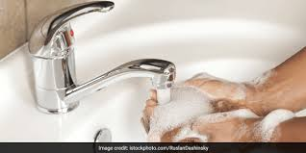

Combat Covid-19
Community outreach
-Masks, Sanitizers
Rewarding employees for innovative minds
- 9 projects exclusively designed to combat Covid-19

Slide 10
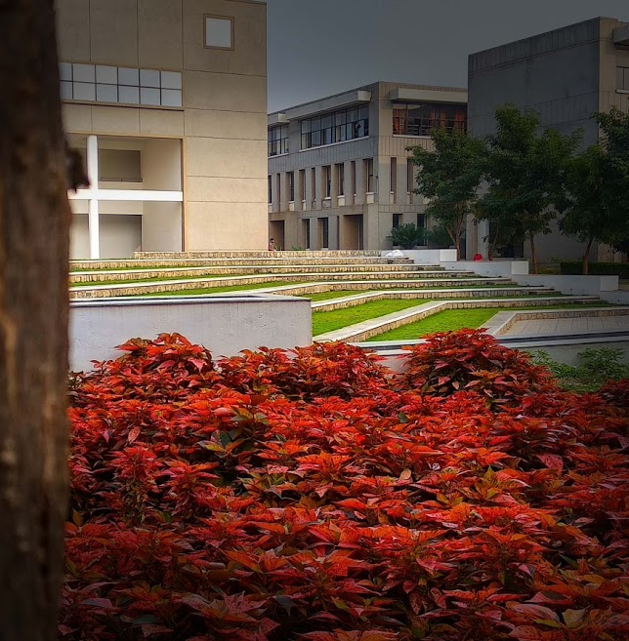
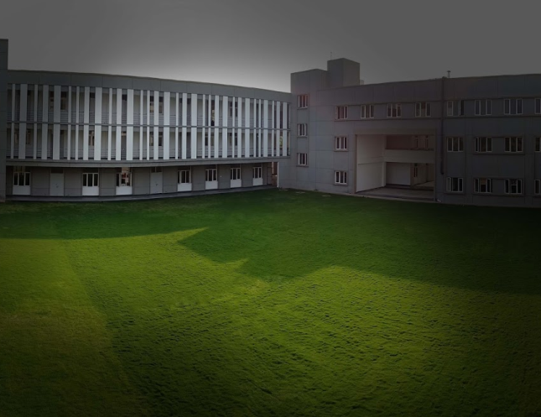
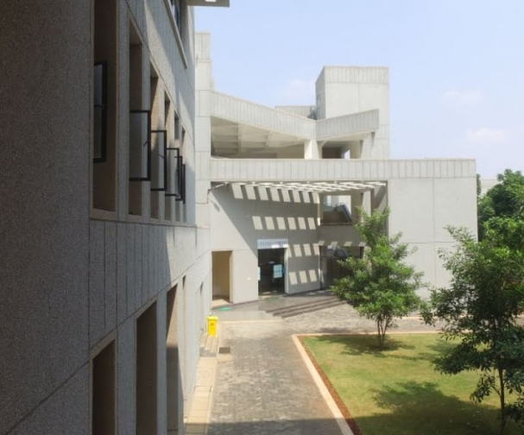
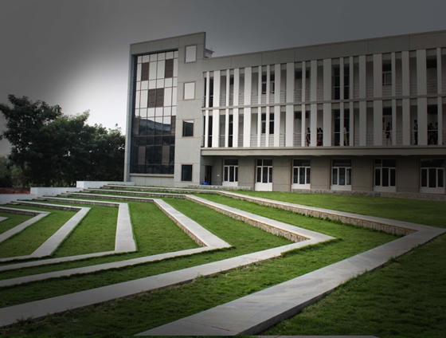
LUSH GREEN CAMPUS

Slide 11
We have achieved!
.
Uninterrupted coaching and continuous enhancement of knowledge.
Unprepared → Qualified within weeks.
Frictionless movement in Teaching Learning Process.

Slide 12
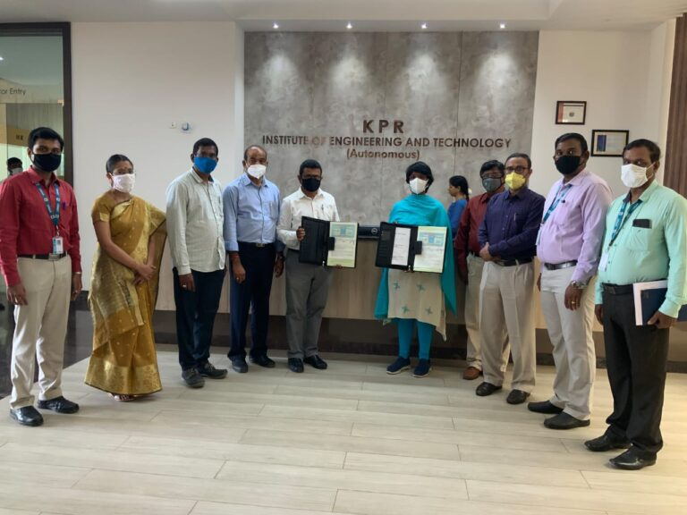
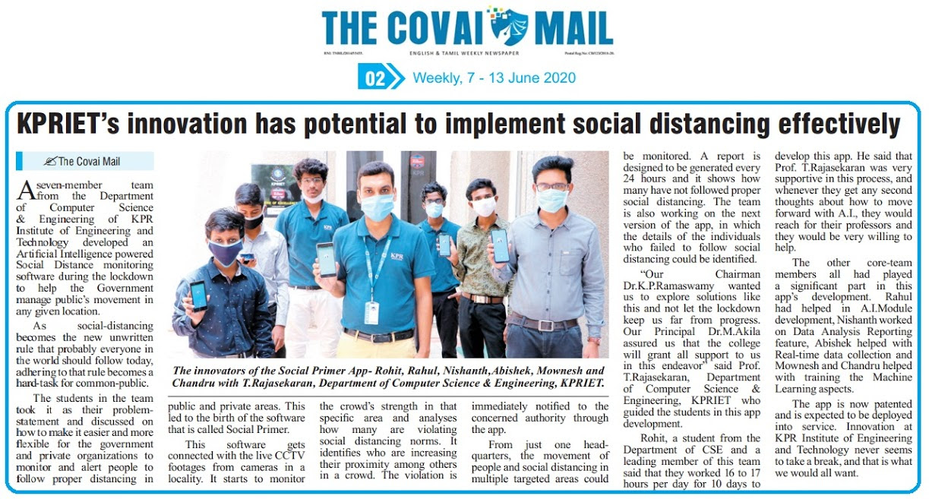
Making KPRIET, a best place to Learn beyond
and Innovate!
Products
.

Slide 13
Practising like we have never won! Performing like we have never lost!
THANK YOU!!

